Slide 1
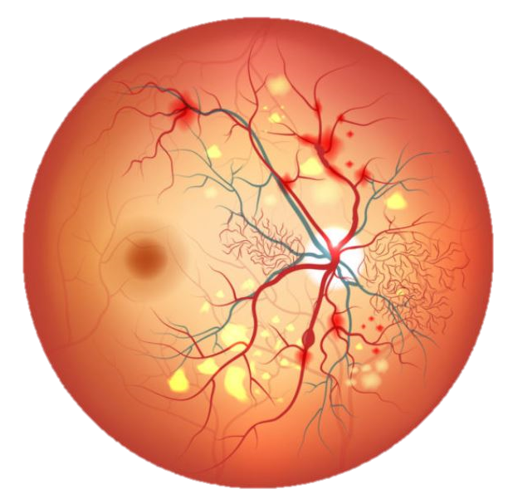
Retinal Vessel Image Segmentation via U-Net Based Attention Mechanism
EN.601.482/682 Deep Learning
Lin Cheng, Kefan Song, Tianyi Ye, Yi Zhang
Notes:
Lin

Slide 2
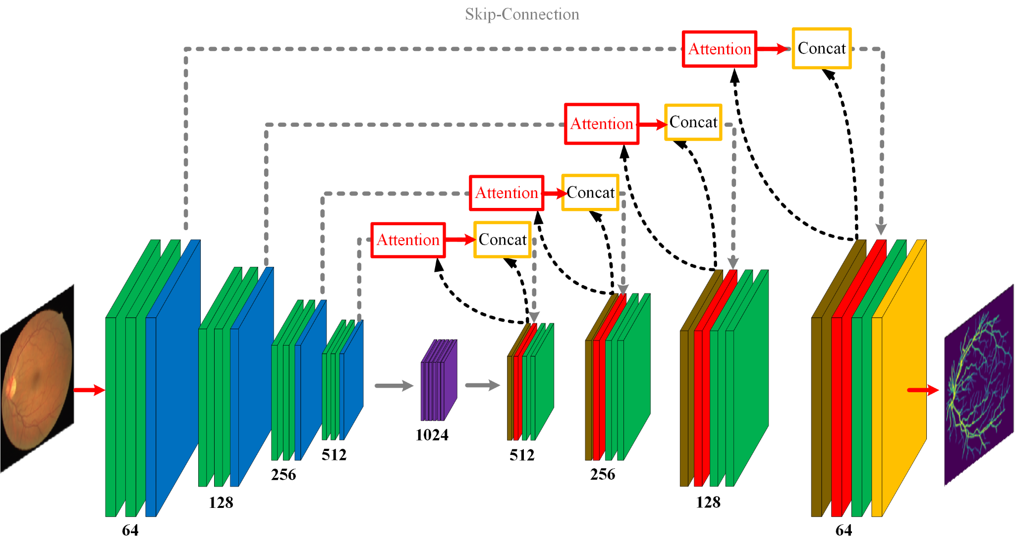
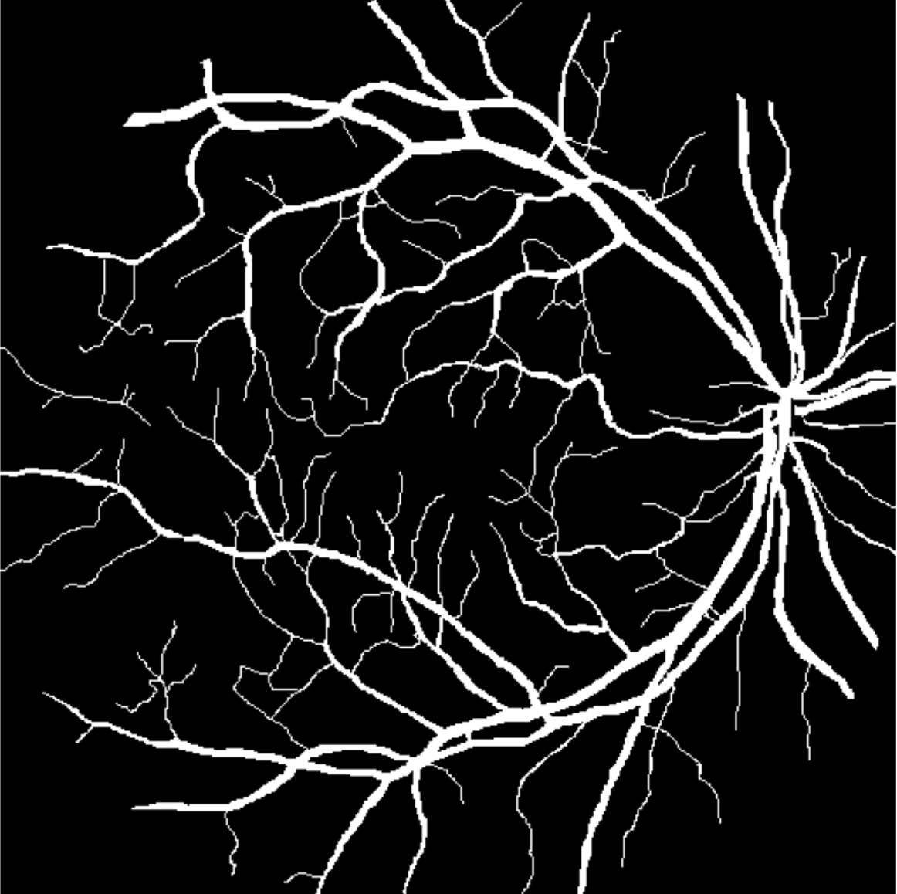
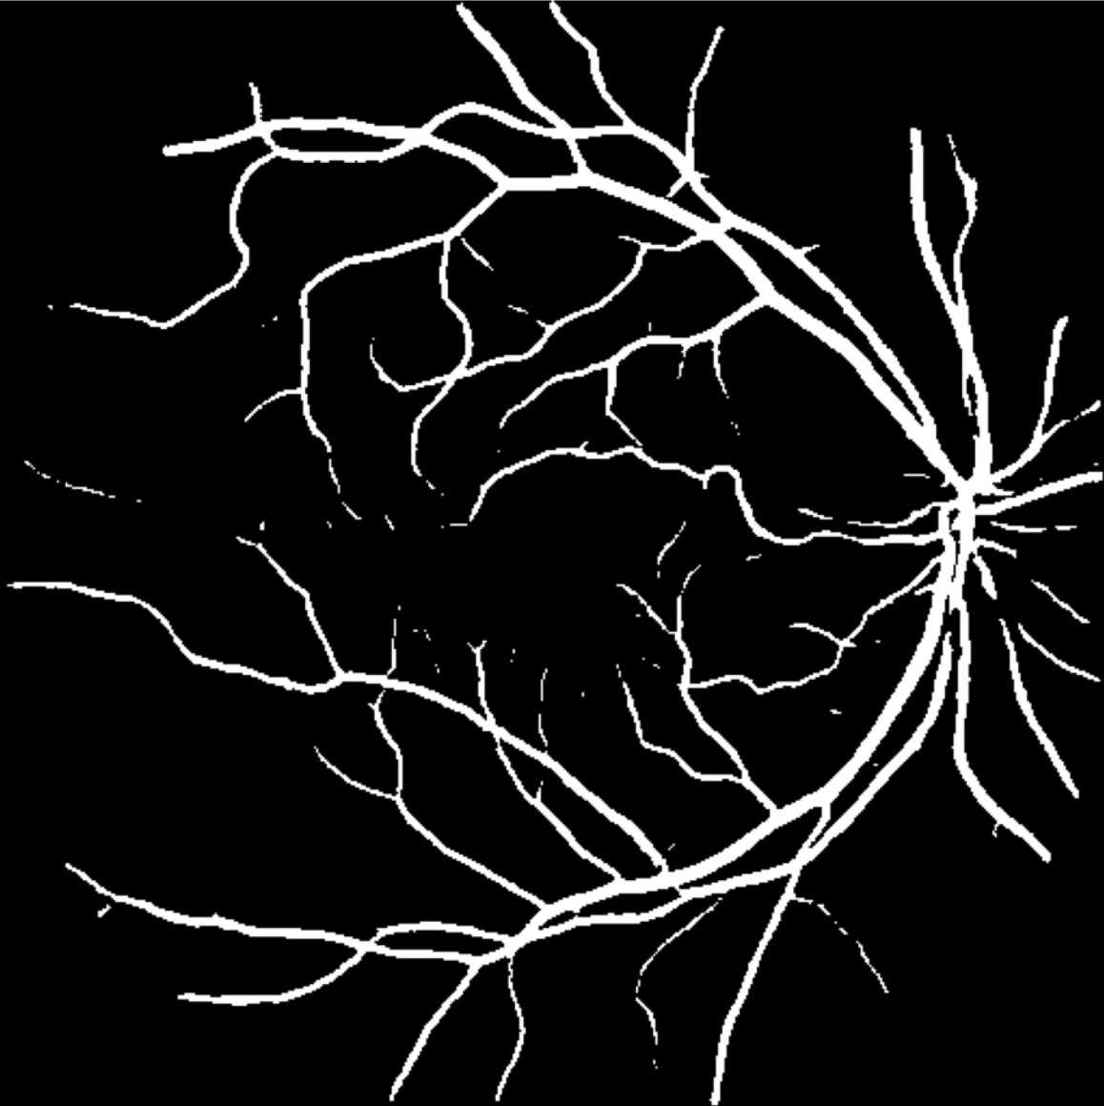
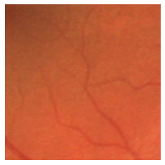
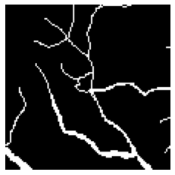
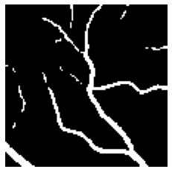
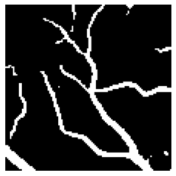
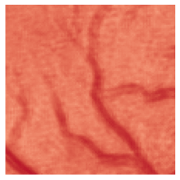
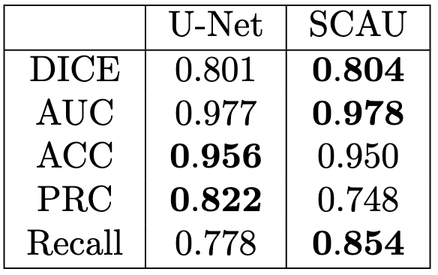
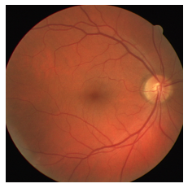
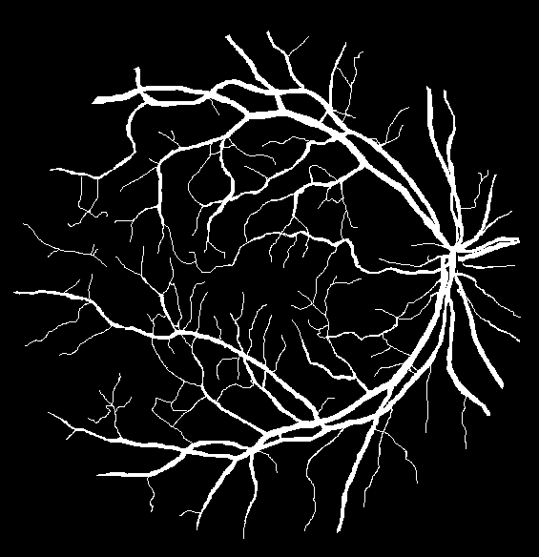
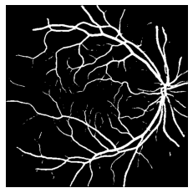
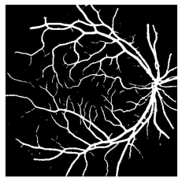
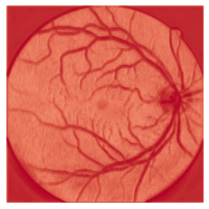
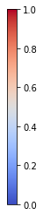
Issue: Tiny Vessel Segmentation
Model
Ground Truth
U-Net
Results
P: 0.6343
R: 0.7430
D: 0.6635
P: 0.5289
R: 0.8275
D: 0.6453
P: 0.8100 R: 0.8015 D: 0.7879
P: 0.7095 R: 0.8767 D: 0.7843
Input
Ground truth
U-Net
Prediction
Attention Map
Spatial-channel

Slide 3
Background
Retinal vessel segmentation
Studies morphological features of the retinal vessels (e.g. length, branching patterns, etc.)
Indicates possible related diseases that may impair human vision.
Currently segmentation and analysis of the vascular features are performed manually
However…Time consuming and inconsistent accuracy
Need fast and accurate segmentation
U-Net commonly used
Problem with U-Net: lack ability in detecting very fine structures
Notes:
Lin

Slide 4
Issue: Tiny Vessel Segmentation
Ground Truth
U-Net
Notes:
Lin

Slide 5
Objective
Improve ability of U-Net based image segmentation to detect tiny vessels
Introduce attention mechanism (channel-wise/spatial-wise)
Interpret how the addition of attention mechanisms leads to performance boost.
Notes:
Lin

Slide 6
Workflow
Data Preprocessing
DRIVE dataset: 40 input images (15 training + 5 validation + 20 testing)
Each cropped into small snippets
Rescale to range [0,1]
Data Augmentation
Random horizontal and vertical flip
Model Building
U-Net Baseline
Hyperparameter tuning using validation set
+ Attention Block (ABU)
+ Spatial Attention (SAU)
+ Channel Attention (CAU)
+ Spatial-Channel Attention (SCAU)
Model Performance Evaluation
Attention Map
Performance metrics: DICE, Accuracy (ACC), AUC, Recall, Precision (PRC)
Visualization
Notes:
Lin

Slide 7
Architecture
Figure 1. U-Net based architecture with integrated attention blocks.
Notes:
It is just a basic U-Net module without Attention and Concat module. In order to segment tiny vessels better, we introduce four different attention gate into the orginal U-Net, then concatenate each of the skip connection which is fed into attention gate, with the up-sampled feature map from each decoder block.

Slide 8
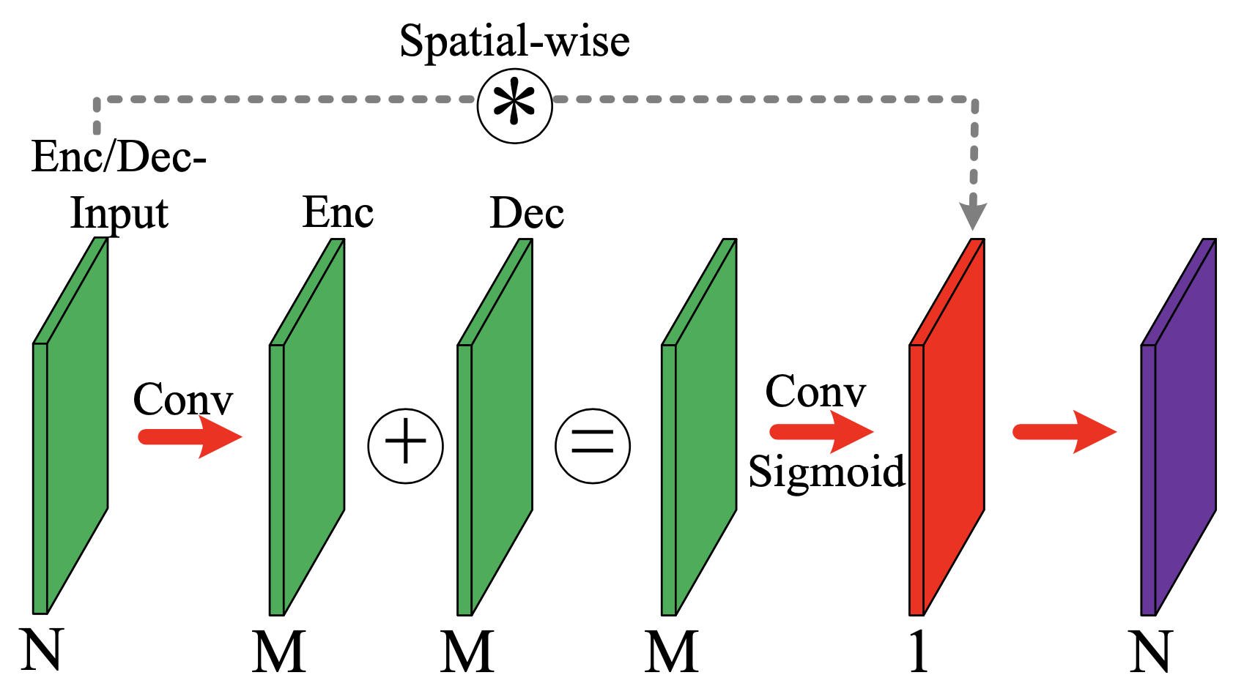
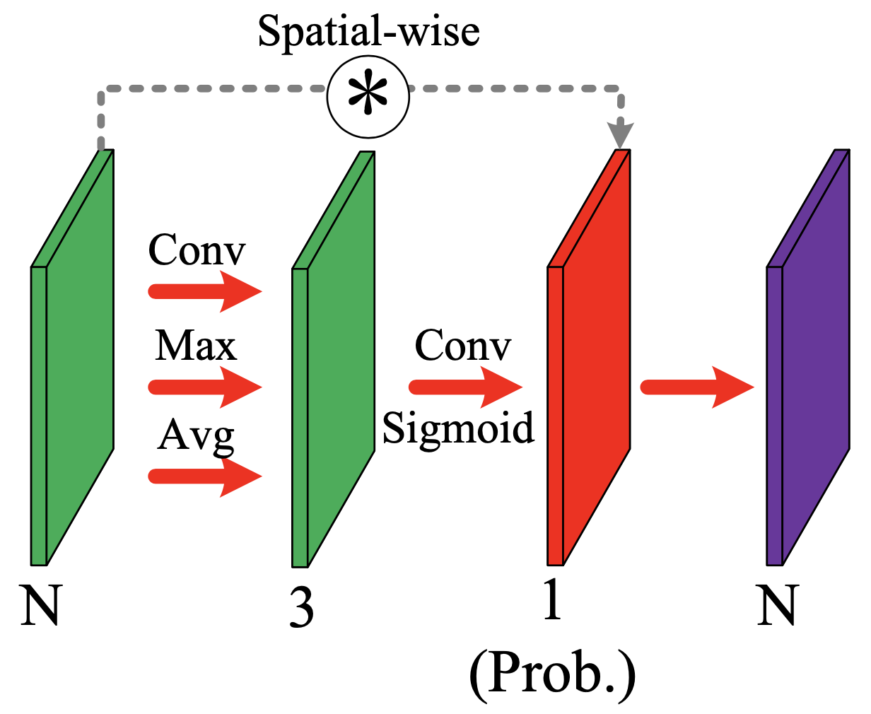
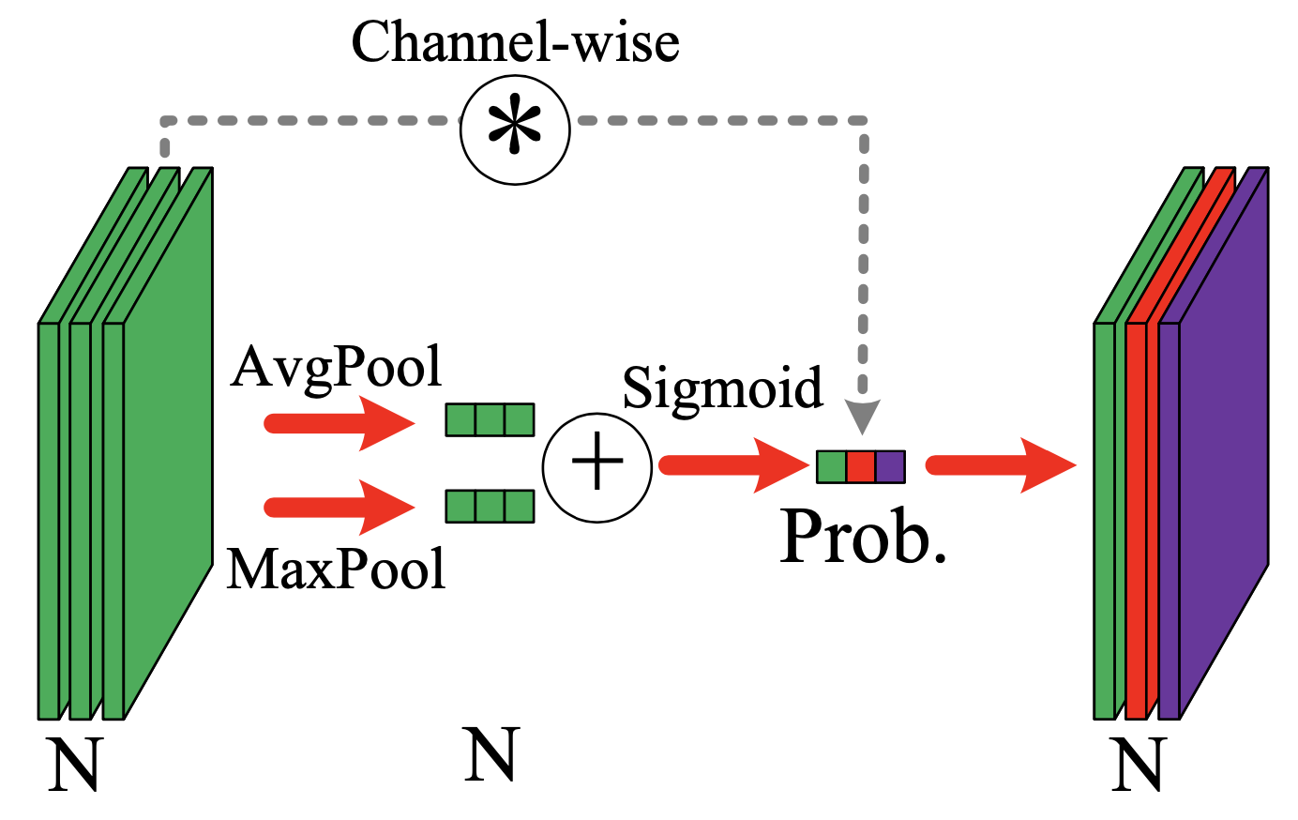
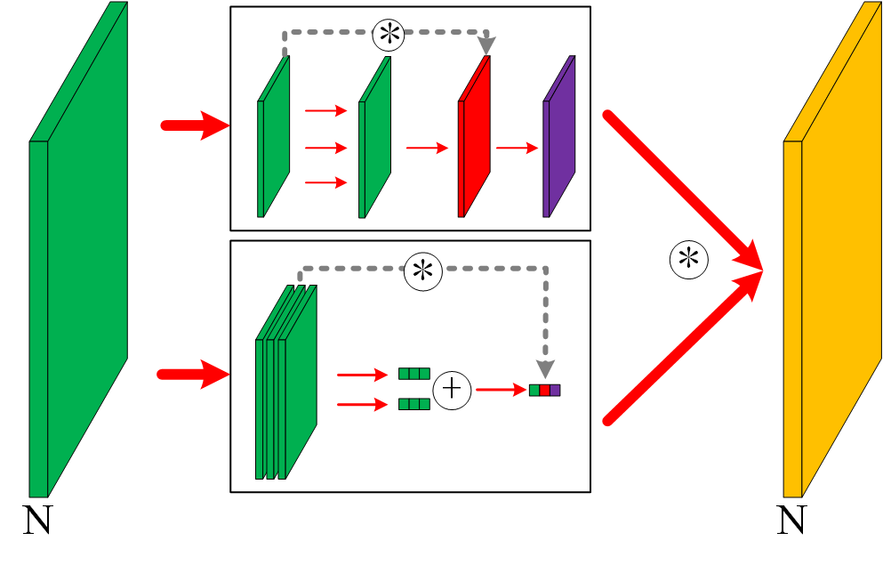

Attention
Attention Block
Spatial Attention
Channel Attention
Spatial-Channel Attention
Spatial Attention
Channel Attention
: Element-wise multiplication
Notes:
the first gate on the left top, is attention block, by adding feature maps from encoder and decoder with a conv layer, to attend. the right top is Spatial attention, by generating attention map from the max, avg and conv layers. the left bottom is channel attention, by re-weighting the channel weights of the original. the last on the right bottom, is spatial-channel attention, by using the strategy of sptial and channel attention in parallel.

Slide 9
Spatial Attention
Channel Attention

Slide 10
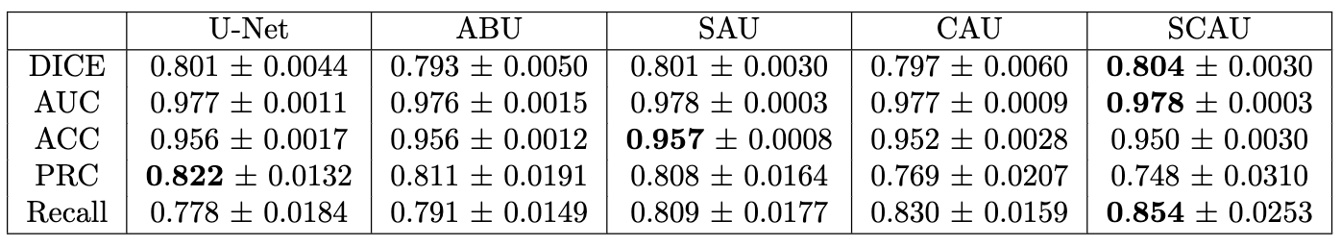
Result
Table 1. Performance of different networks on retinal image segmentation.
Notes:
Kefan

Slide 11

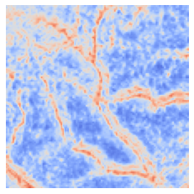
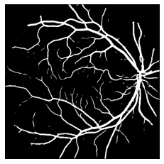
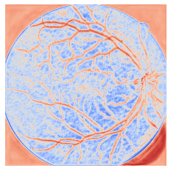
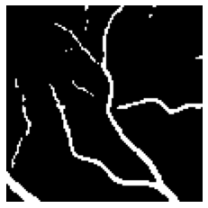
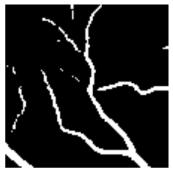
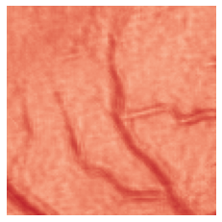
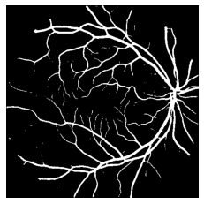

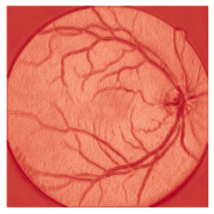
Result (cont.)
P: 0.6343
R: 0.7430
D: 0.6843
P: 0.6465
R: 0.7019
D: 0.6730
P: 0.8100 R: 0.8015 D: 0.8058
P: 0.7929 R: 0.8137 D: 0.8031
Input
Ground truth
U-Net
Prediction
Attention Map
Attention Block
P: 0.6696
R: 0.7066
D: 0.6876
P: 0.6285
R: 0.7207
D: 0.6714
P: 0.5289
R: 0.8275
D: 0.6453
P: 0.8176 R: 0.7913 D: 0.8042
P: 0.8030 R: 0.8001 D: 0.8015
P: 0.7095 R: 0.8767 D: 0.7843
Channel
Prediction
Attention Map
Prediction
Attention Map
Spatial
Spatial-channel
Figure 2. Comparison of visualization outputs from different networks (P: PRC, R: Recall, D: Dice score).
Notes:
Kefan

Slide 12
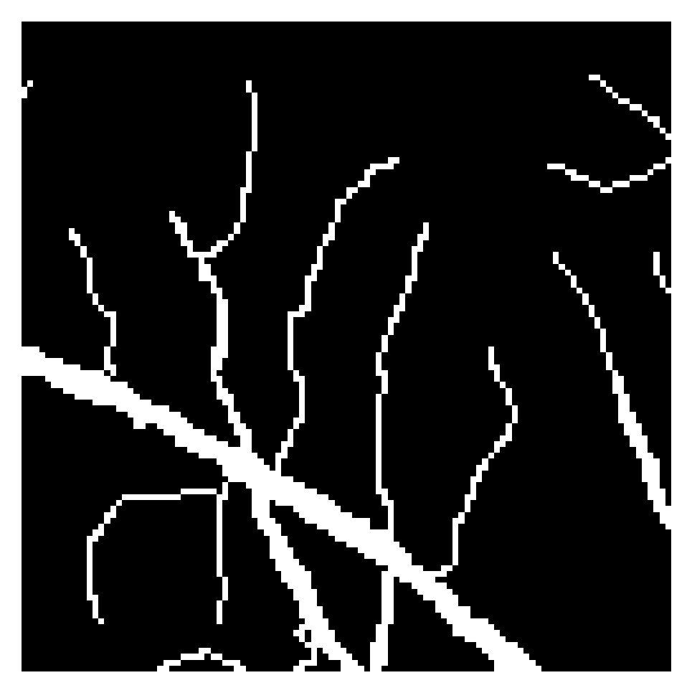
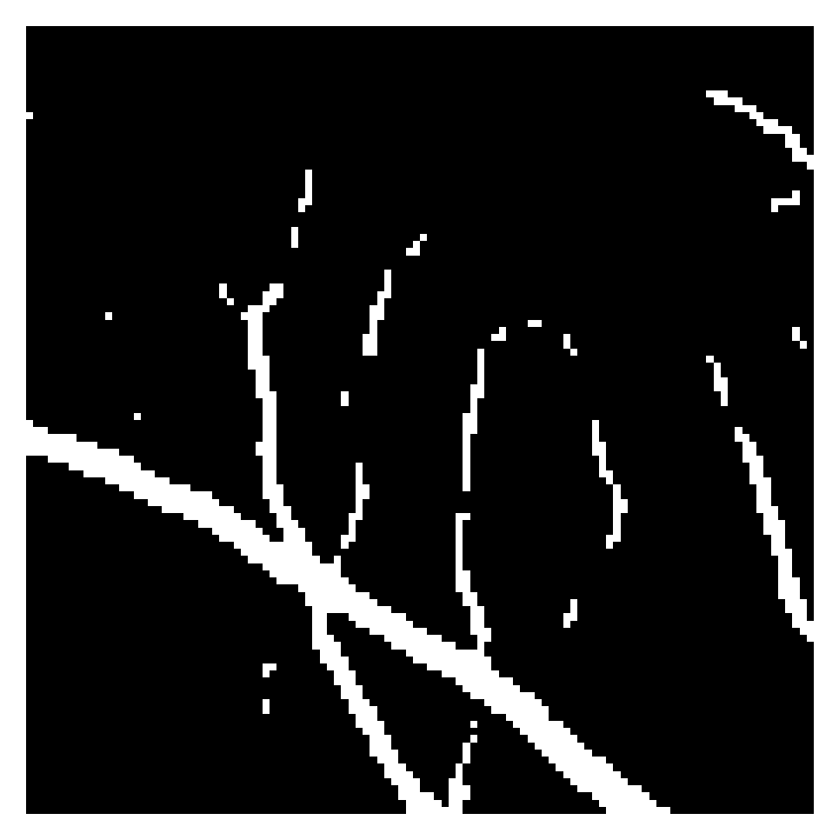
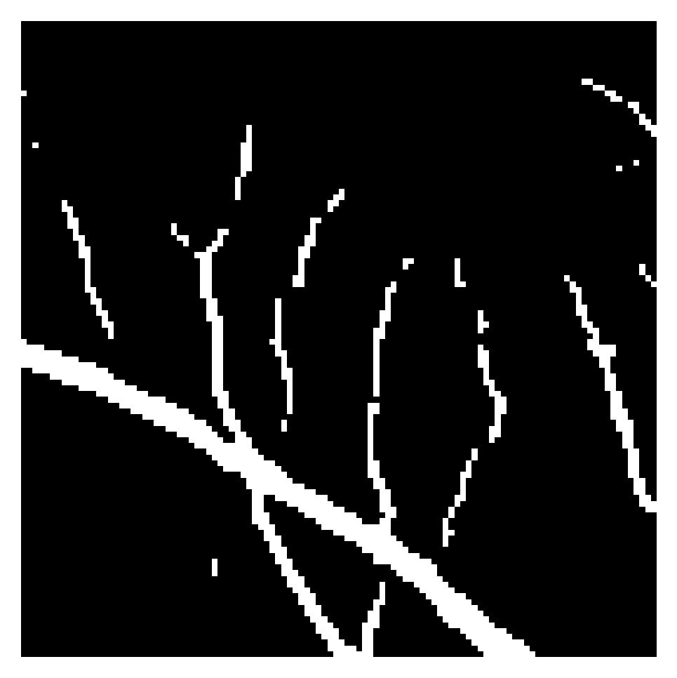
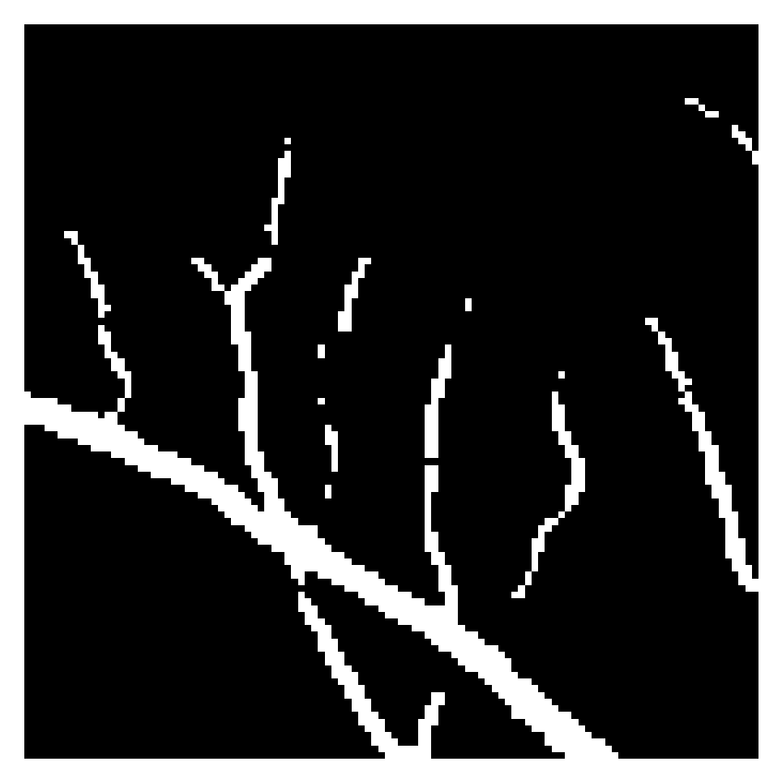

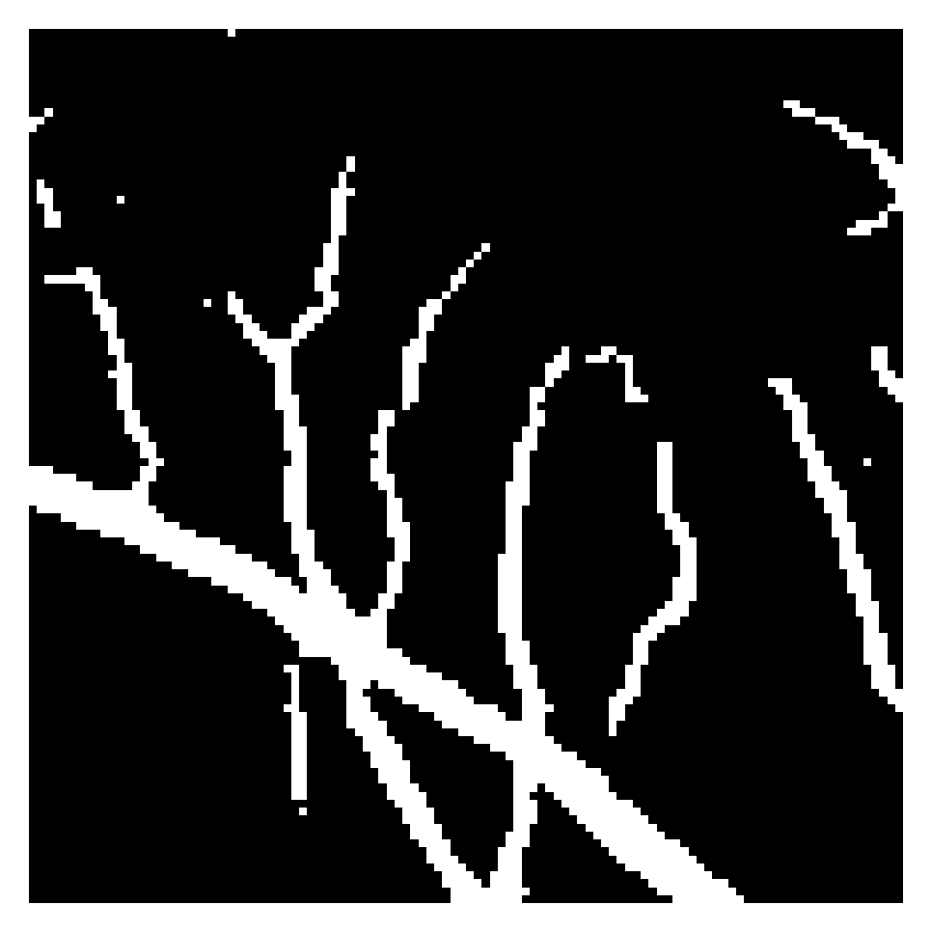
Visualization
Ground truth
U-Net
Channel
Attention Block
Spatial
Spatial-channel
Figure 2. Comparison of visualization outputs that showcase the ability of different networks to detect small vessels.
Notes:
Kefan

Slide 13
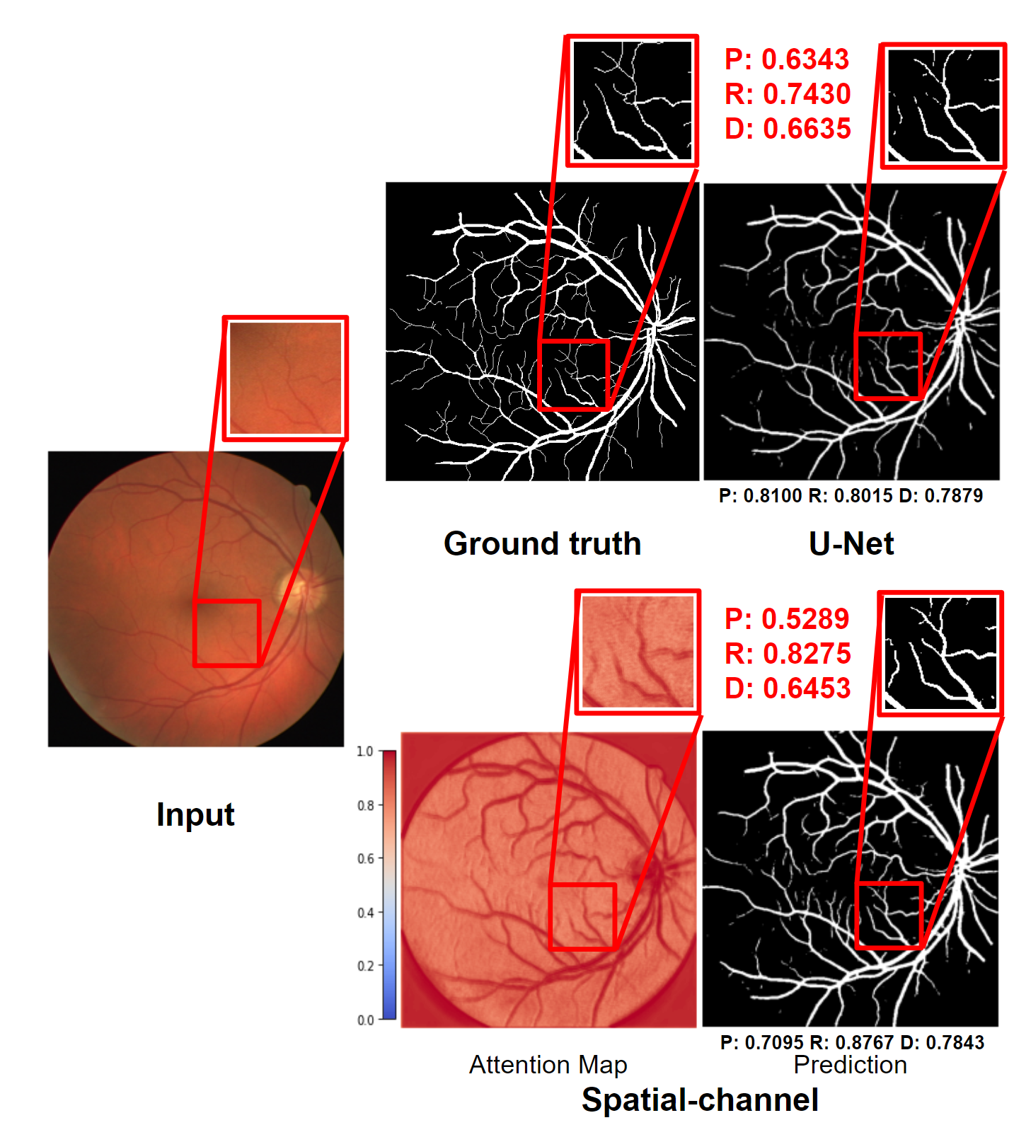
U-Net vs. SCAU-Net
Table 2. Performance of U-Net and SCAU-Net.
Compared to the U-Net baseline, SCAU increases recall significantly while sacrificing PRC, and also achieved better predictions on small vessels.
Figure 3. Comparison of visualization outputs from original U-Net and Spatial-channel U-Net.
Notes:
Tianyi

Slide 14
Future Directions
Include residual logic to achieve better performance as model capacity increases with attention mechanisms.
Further data augmentation methods and dropout layers may be necessary to alleviate the potential problem of overfitting.
Alternative loss functions may also be implemented to achieve better precision while maintaining the recall score.
Notes:
Tianyi

Slide 15
Conclusion
Introduced attention mechanism to detect tiny vessels
Dice/AUC/ACC score for all models are similar
SCAU-Net works best in detecting tiny vessels
Addition of attention mechanisms leads to decline in precision in exchange for boost in recall.
Notes:
Tianyi

Slide 16
Retinal Vessel Image Segmentation:
Performance Improvement on U-Net Based Architecture and Attention Mechanism
EN.601.482/682 Deep Learning
Lin Cheng, Kefan Song, Tianyi Ye, Yi Zhang
P: 0.6343
R: 0.7430
D: 0.6635
P: 0.5289
R: 0.8275
D: 0.6453
P: 0.8100 R: 0.8015 D: 0.7879
P: 0.7095 R: 0.8767 D: 0.7843
Ground truth
U-Net
Prediction
Attention Map
Input
Spatial-channel
Notes:
Tianyi

